Slide 1
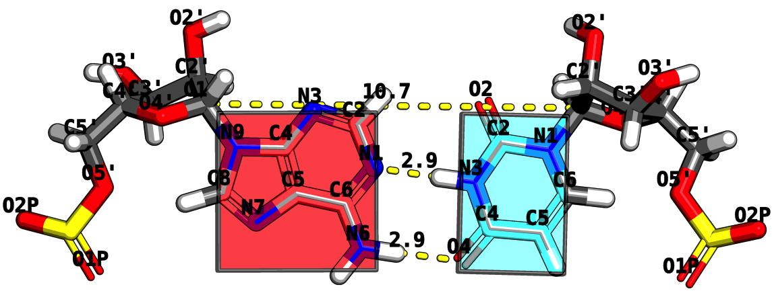
RNA Structure Analysis via the Rigid Block Model
Mauricio Esguerra
October 5th, 2010
Chemistry and Chemical Biology Department
Rutgers, The State University of New Jersey

Slide 2
Program
Opening Act
THE CHALLENGE: How does RNA fold?
Act I
BASE STEPS: Dinucleotide step classification using single-stranded base step parameters.
Act II.
BASE PAIRS: Base pairs in RNA helical regions.
Act III
BASE PAIR STEPS: From local to global properties in RNA with the aid of rigid-blocks.
Act IV
RNA STRUCTURAL MOTIFS: RNA structural motifs identification using rigid-blocks.
Finale
Notes:
Change it to Act I, Act II, etc. → Intermezzo.

Slide 3
Opening ACT
THE CHALLENGE:
How does RNA Fold?
Is this an easy or hard problem?

Slide 4
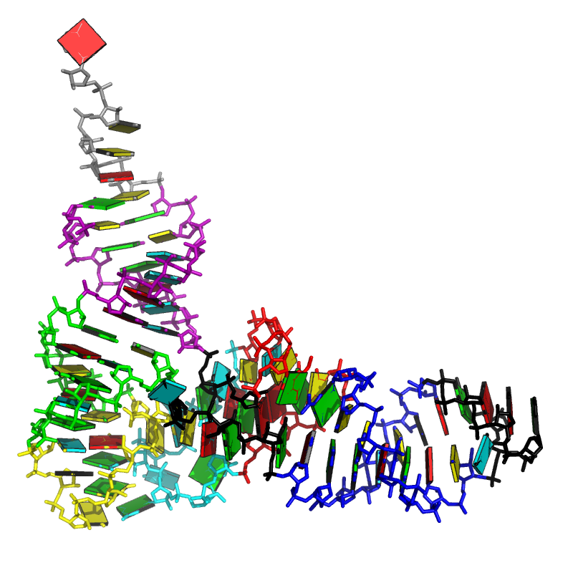
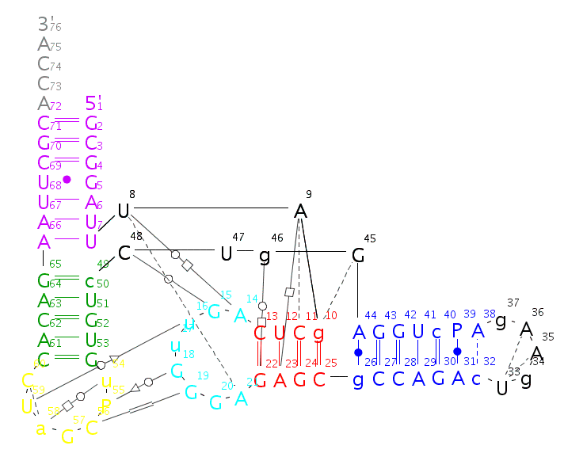
CHALLENGE How does RNA Fold?
GCGGAUUUAGCUCAGUUGGGAGAGCGCCAGACUGAAGAUCUGGAGGUCCUGUGUUCGAUCCACAGAAUUCGCACCA

Slide 5
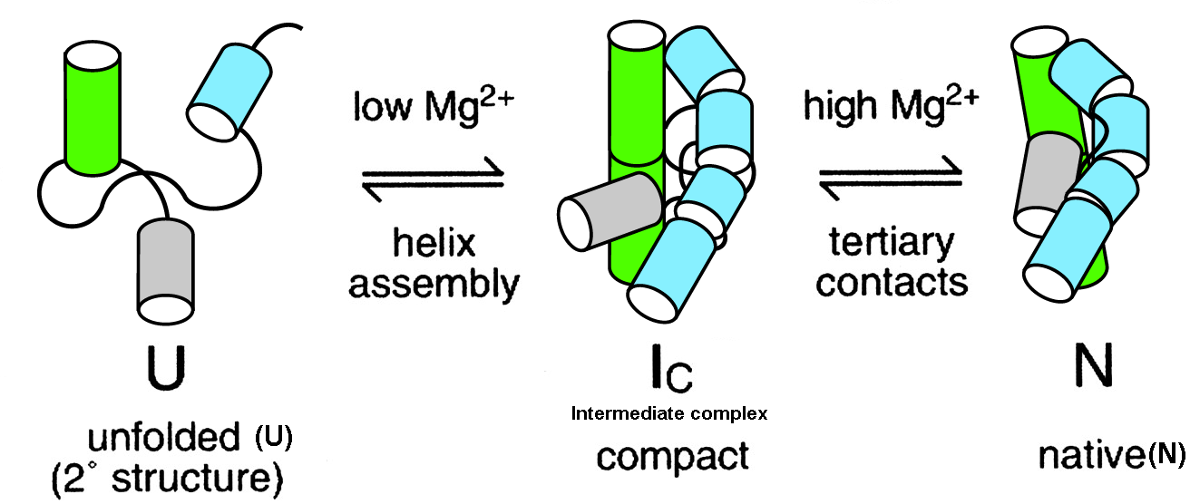
CHALLENGE Is RNA folding a hard or easy problem to solve? After all, the RNA alphabet has only 4 words.
No hydrophobic surface burial.
Polyanionic sugar-phosphate backbone.
Secondary and tertiary separated by Mg2++ addition.
Notes:
Too long.
Have the CHALLENGE IN ALL TO CONNECT TO OUTLINE!

Slide 6
CHALLENGE Usual ways to classify RNA conformations and an unexplored one -- the rigid-body perspective --.
The atom-based perspective
Comparison of backbone atom xyz.
Comparison from set of backbone, sugar, base, atoms xyz.
The bond-based perspective
Covalent bonds – backbone + glycosidic torsions.
Pseudo-bonds η and θ.
Hydrogen bonds forming in edge boundaries (Watson-Crick, Sugar, and Hoogsten).
The rigid-body-based perspective
Base-pair parameters.
Base-pair (base) step parameters.

Slide 7
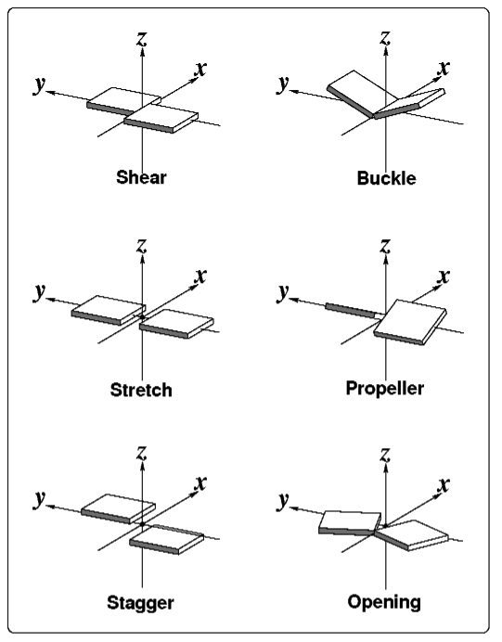
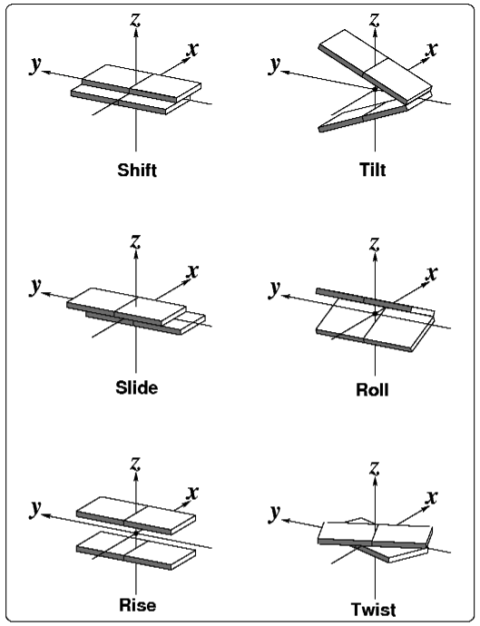
CHALLENGE The mechanical perspective: Nucleic acid bases seen as rigid-bodies.
Base-pair parameters
Base-pair-step parameters

Slide 8
ACT I
Dinucleotide step classification using single-stranded base step parameters
Notes:
Look at what is before ACT, to give it a name as motivation.

Slide 9
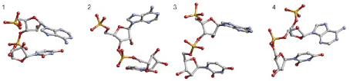
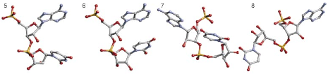
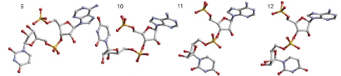
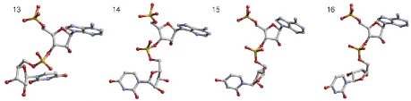
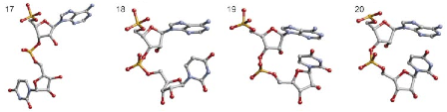
BASE STEPS 18 non-A-RNA, AII-RNA, and canonical A-RNA conformers kindly provided by Berman and collaborators.
Schneider et al. (2004) NAR, 32, 1667-1677.
Notes:
Schneider et al. structures with the original numbering. Don’t forget to write kindly provided by.

Slide 10
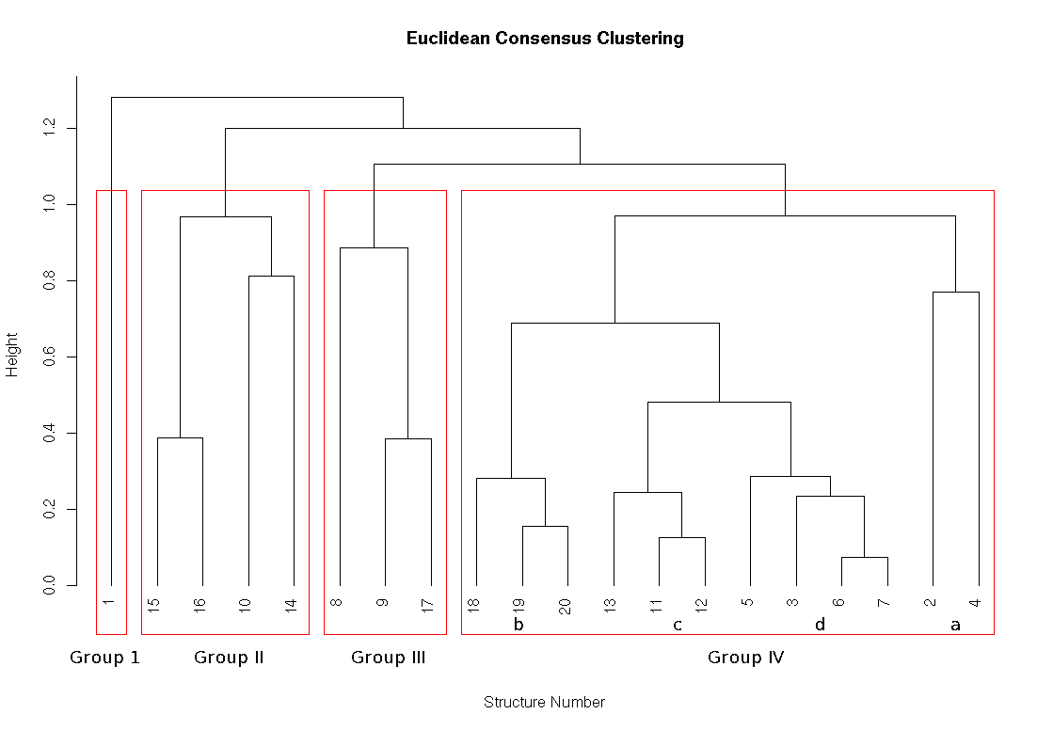
BASE STEPS Consensus clustering using classification techniques for the periodic table of the elements.

Slide 11
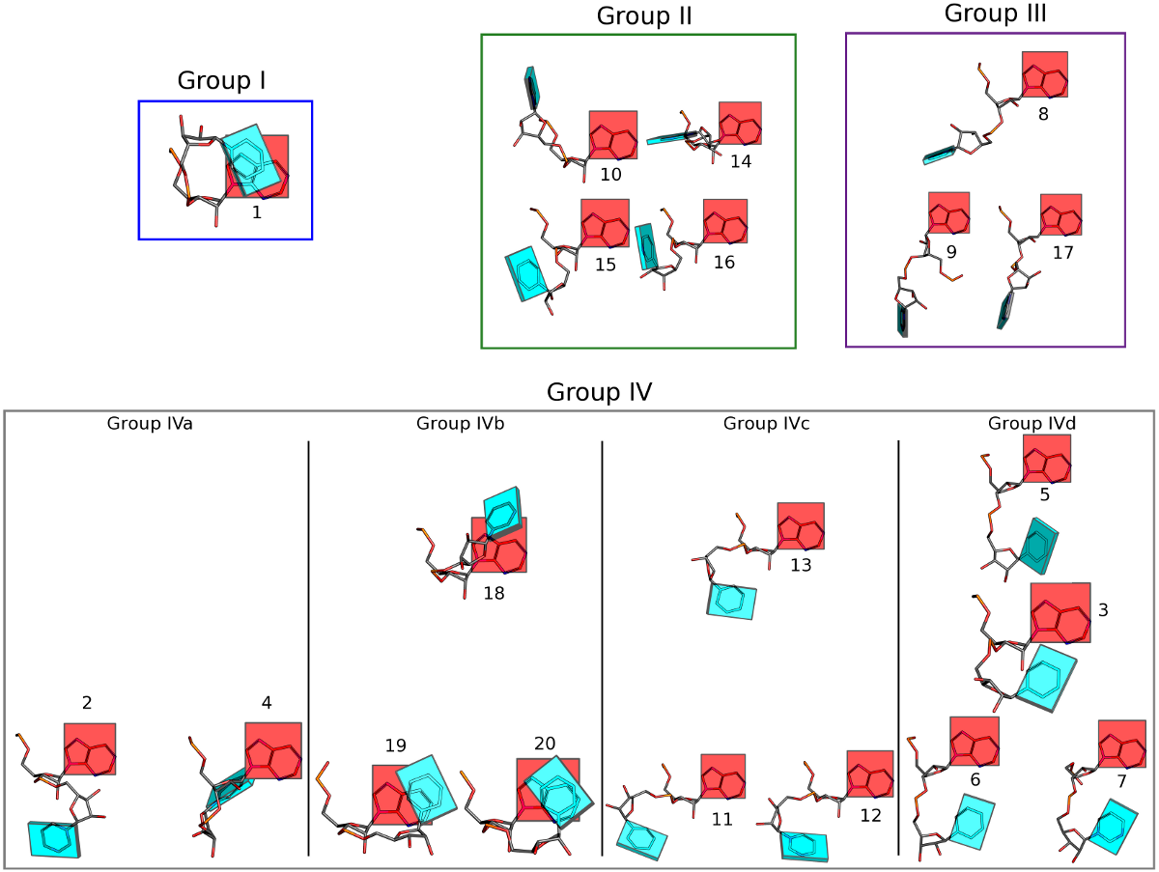

Slide 12
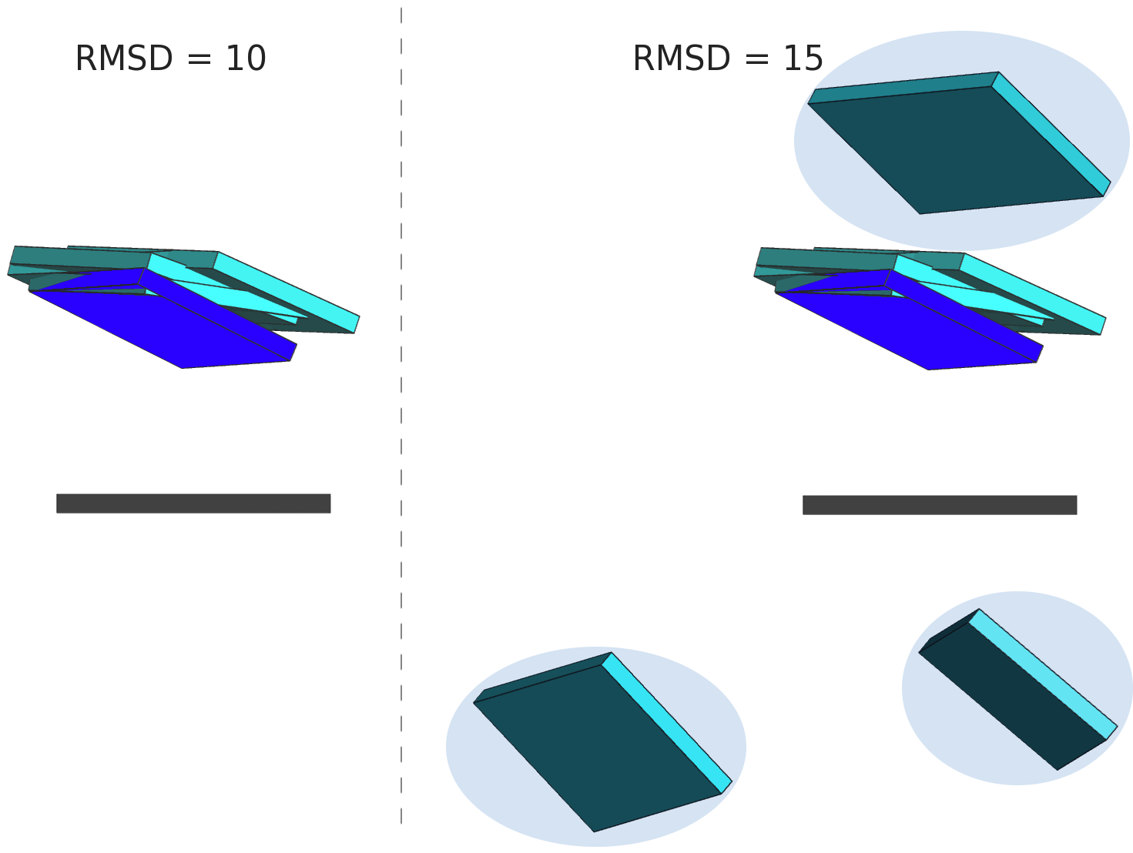
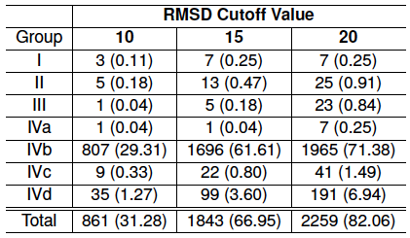
BASE STEPS Only a small fraction ~ 30 % of dinucleotide step conformations are represented in the ribosome.
In parentheses percentages of
confomer groups found in the 23S
subunit of the ribosome, PDB_ID: 1JJ2
Notes:
Subscript what’s in parentheses.

Slide 13
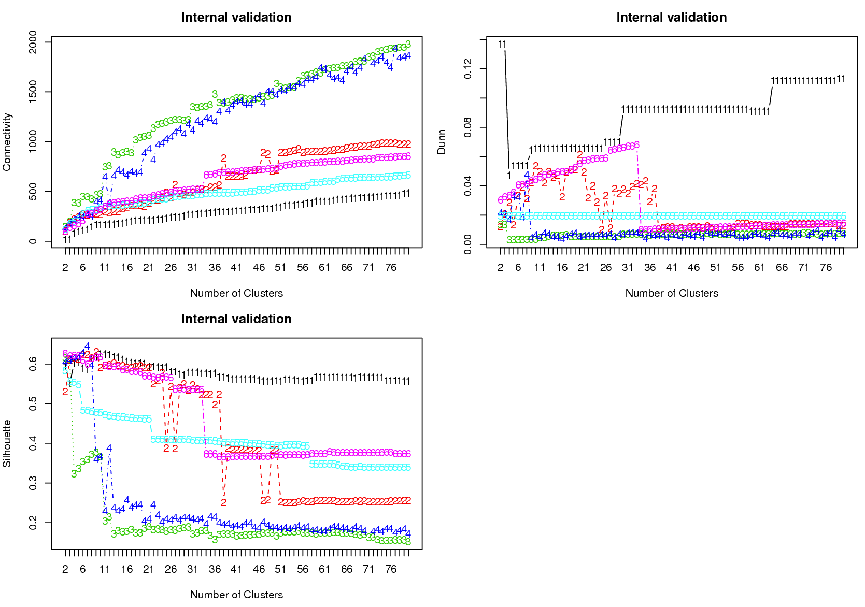
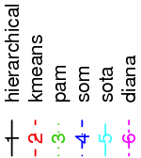
BASE STEPS Instead of picking any clustering methodology we use the clValid R package for cluster validation.
Connectivity small
Silhouette large
Dunn Index large

Slide 14
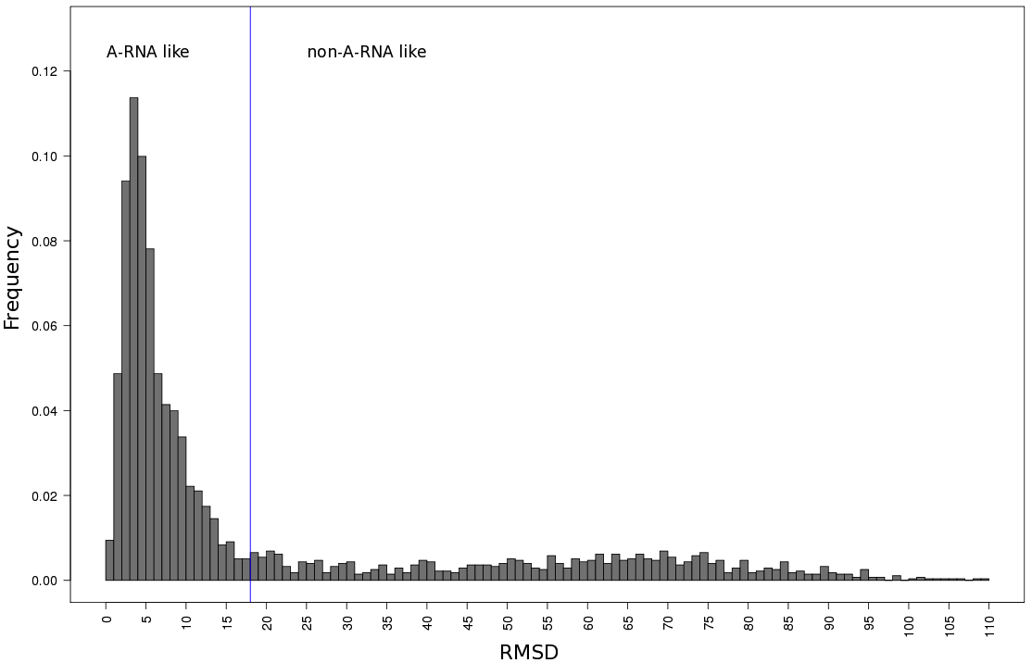
BASE STEPS Selecting A-RNA and non-ARNA-like datasets using distance to canonical ARNA parameters.
71% (1956)
29% (797)

Slide 15
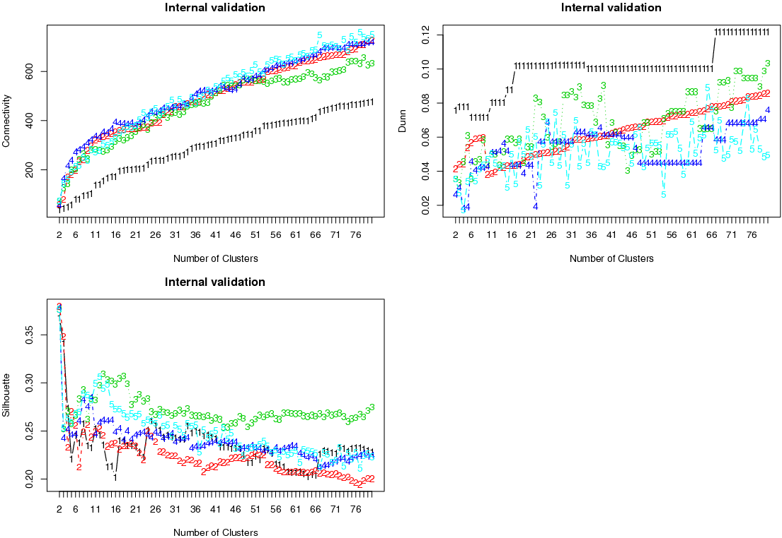
BASE STEPS For the non-A-RNA-like dinucleotide steps the best clustering method is the hierarchical one. k =67.
Connectivity small
Silhouette small
Dunn Index large
Notes:
Make sign at k=67
Make labels clearer
Make label of score trends better when.

Slide 16
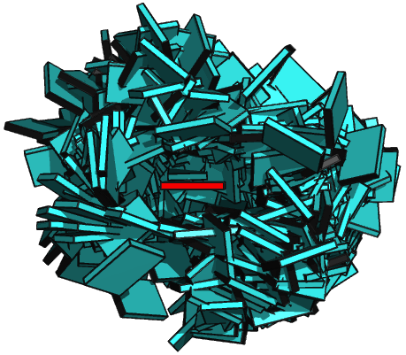
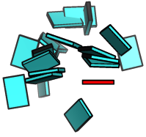

BASE STEPS Non-ARNA-like torsion angle conformers do not fill the full space of base geometries.
A-RNA
17 non-A-RNA-like
All non-ARNA
Notes:
Type what are all the groups.
Show the 67 I get, as averages and show that they fill the space better.
Show picture of all.
How many in all non-ARNA

Slide 17
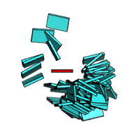
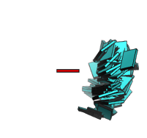
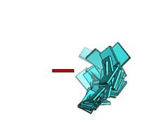
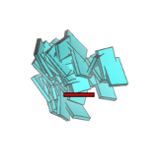
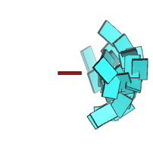
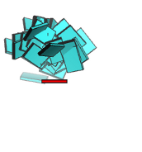
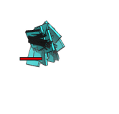
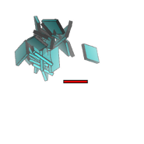
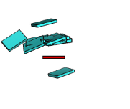
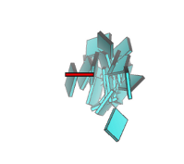
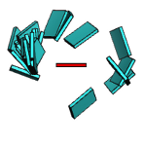
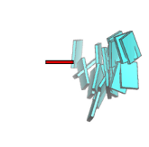
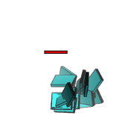
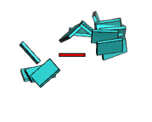
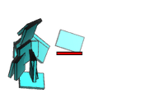
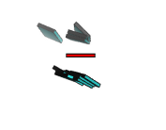
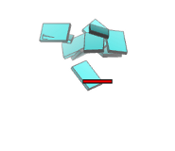
BASE STEPS There are 17 Main Non-ARNA-Like Clusters with ten or more members in them.
Notes:
Include percentages of each group in non-ARNA.
What are the missing groups?

Slide 18
ACT II
Base-pairs in RNA helical regions

Slide 19
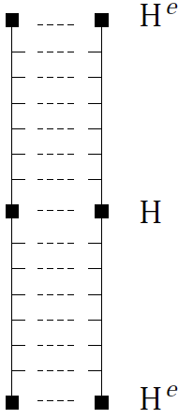
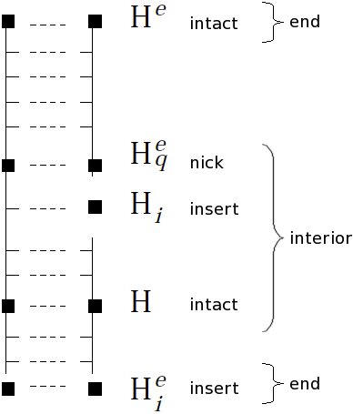
BASE PAIRS Helical regions in 3DNA can be continuous and quasi-continuous.
Notes:
Picture of helical regions in 3D, quasi continuous vs continuous.
Base-pairing preferences, base-sequence preferences, which can be linked to tertiary interactions.

Slide 20
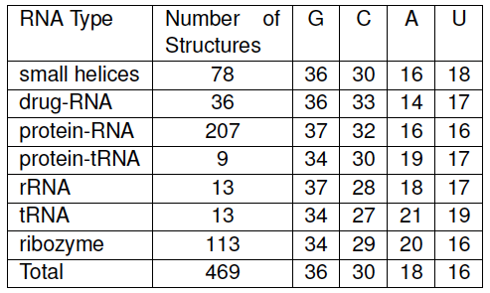
BASE PAIRS Partially non-redundant RNA dataset is GC rich.
Percent composition of nucleotide bases in RNA
helical regions (Helices composed of 3 base-pairs or more).
Notes:
MESSAGE HERE THAT ITS GC RICH

Slide 21
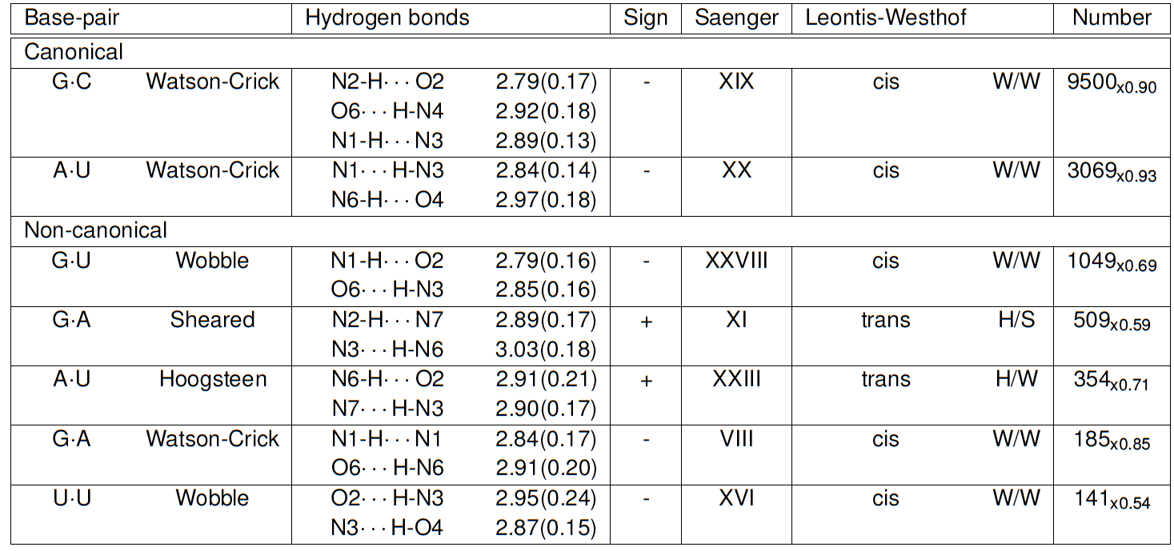
BASE PAIRS Seven predominant base-pairs in RNA helical regions make up to 90% of all base-pairs.

Slide 22
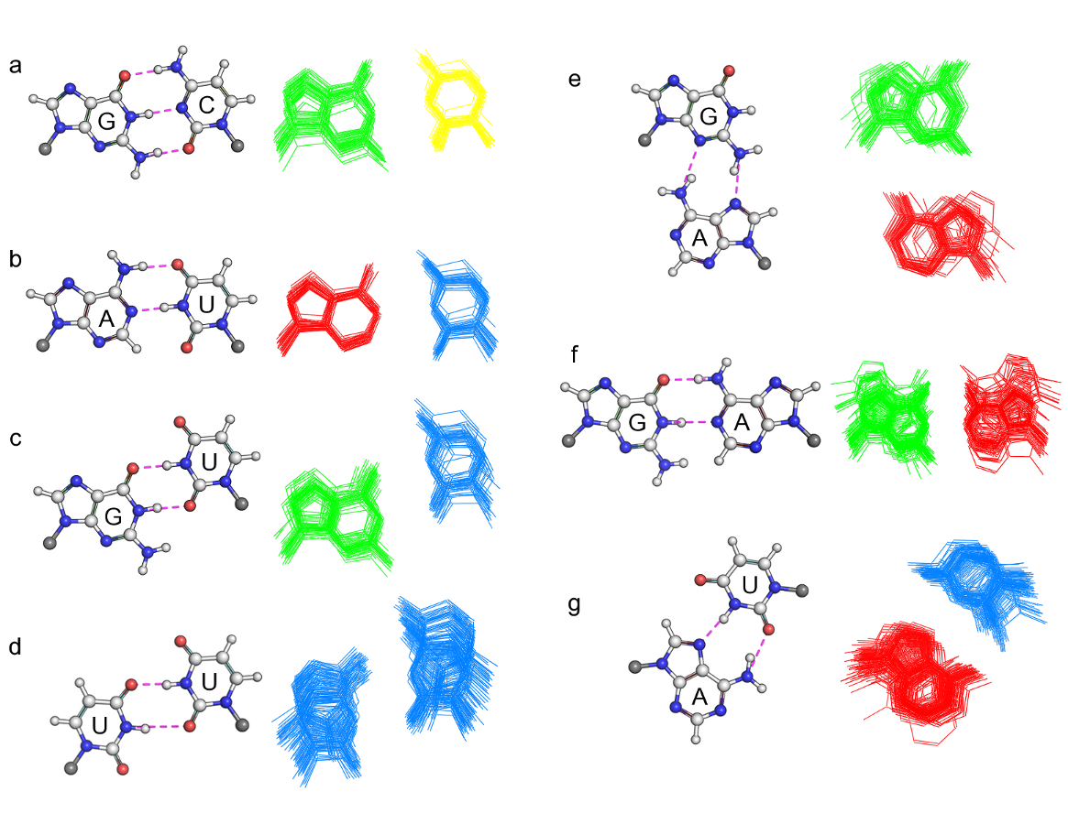
BASE PAIRS Non-canonical base-pairs are more deformable than canonical base-pairs.

Slide 23
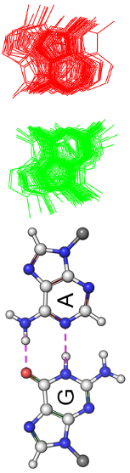
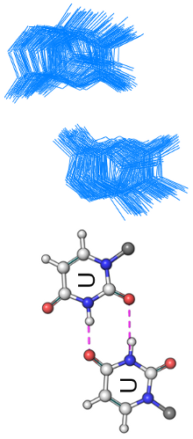
BASE PAIRS Most deformed base-pairs seem as oversized or undersized pieces in a puzzle.

Slide 24
ACT III
Base-pair-steps in RNA helical regions and RNA global properties

Slide 25
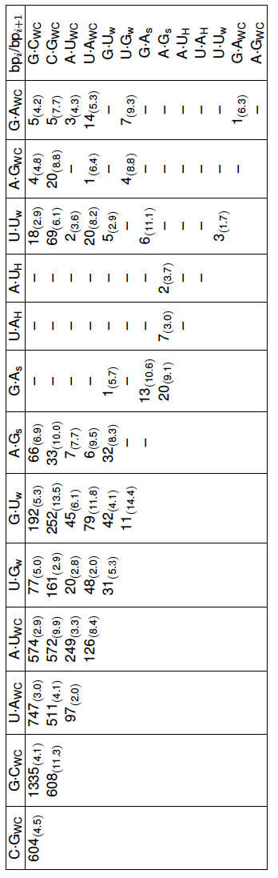
BASE PAIR STEPS RNA base-pair-steps in helical regions are still few when non-canonicals are considered.
Not all possible combinations of base-pairs into base-pair steps
Are found in the studied helical regions.
Sheared G.A and U.Uw stand-out.

Slide 26
BASE PAIR STEPS RNA base-pair-steps parameters in helical regions and energy contours. The rnasteps website.
http://rnasteps.rutgers.edu

Slide 27
Intermezzo

Slide 28
BASE PAIR STEPS – GLOBAL Knowledge of adjacent base-pair steps makes it possible to make up a larger polymer.
Picture with four–five steps, just to illustrate principle. ala atsushi.

Slide 29
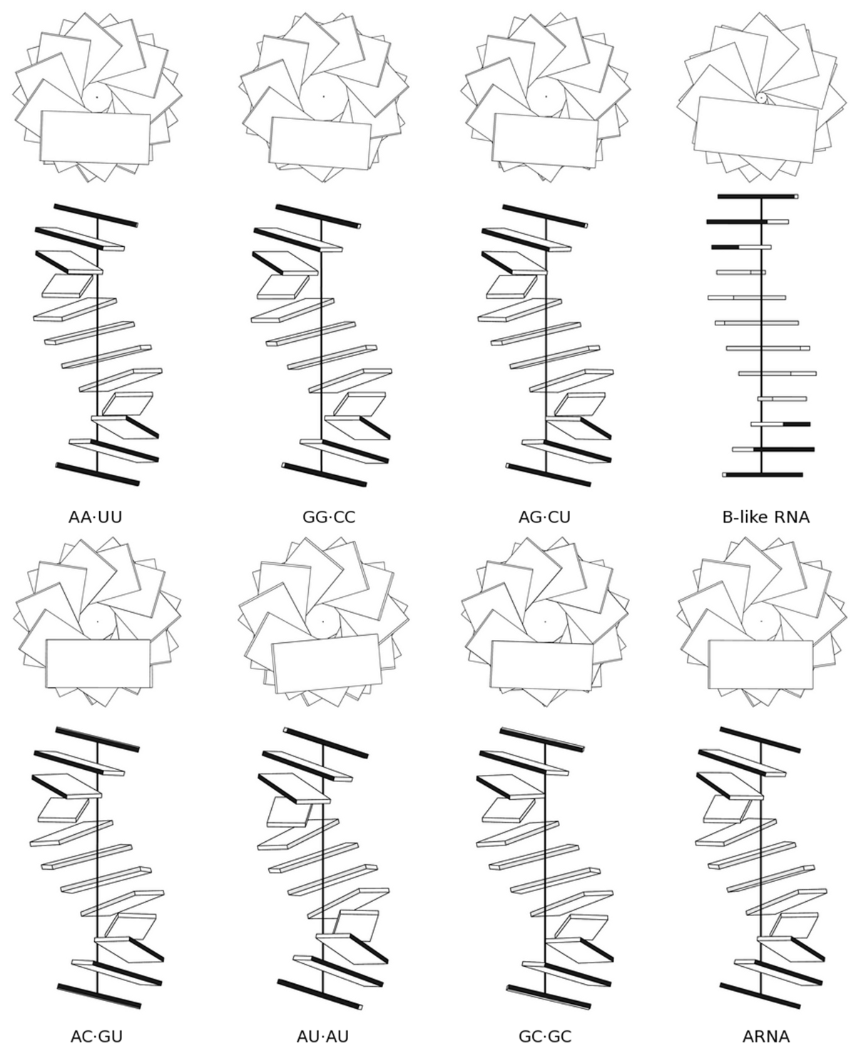
BASE PAIR STEPS – GLOBAL Homopolymers and Block Copolymers
RNA sequence has subtle effects on
the structure of RNA.

Slide 30
BASE PAIR STEPS – GLOBAL
Movie or graph to explain persistence length
Talk about flexibility.
Table of different polymers and their persistence lengths

Slide 31
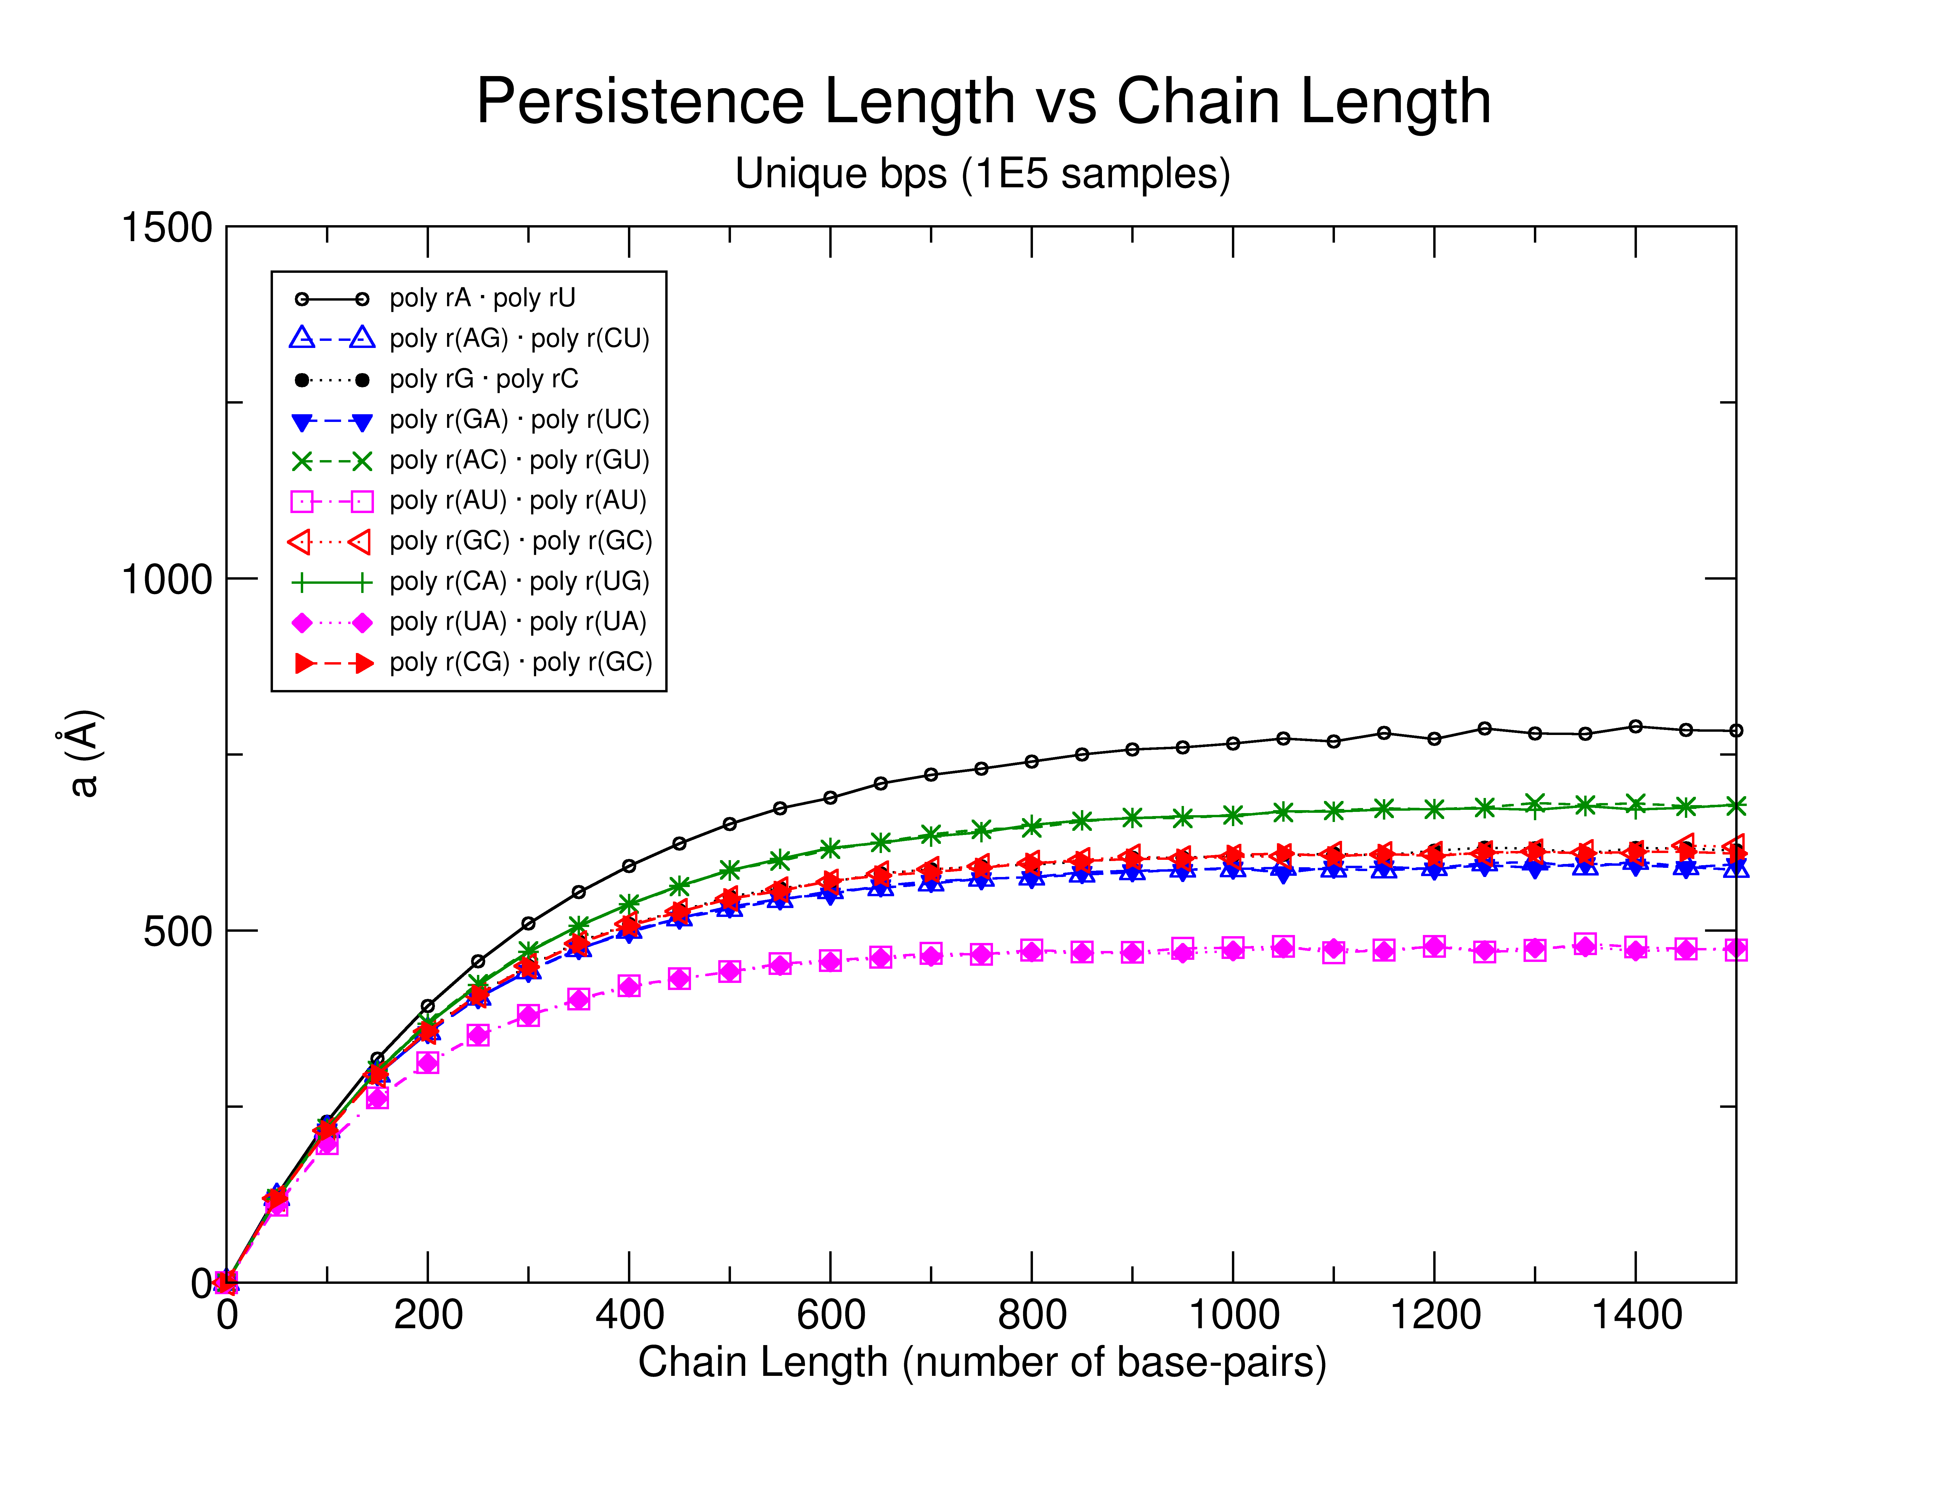
BASE PAIR STEPS – GLOBAL RNA Persistence Length
Message here
Suggest possible sequence
dependence

Slide 32
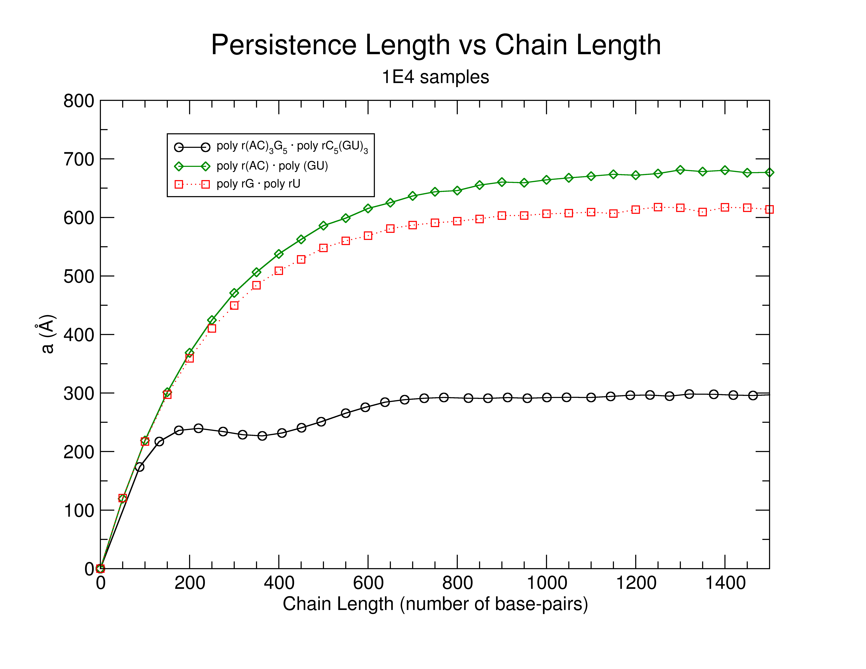
BASE PAIR STEPS – GLOBAL Surprisingly some RNA polymeric chains appear to be curved.
Notes:
FIX GRAPH

Slide 33
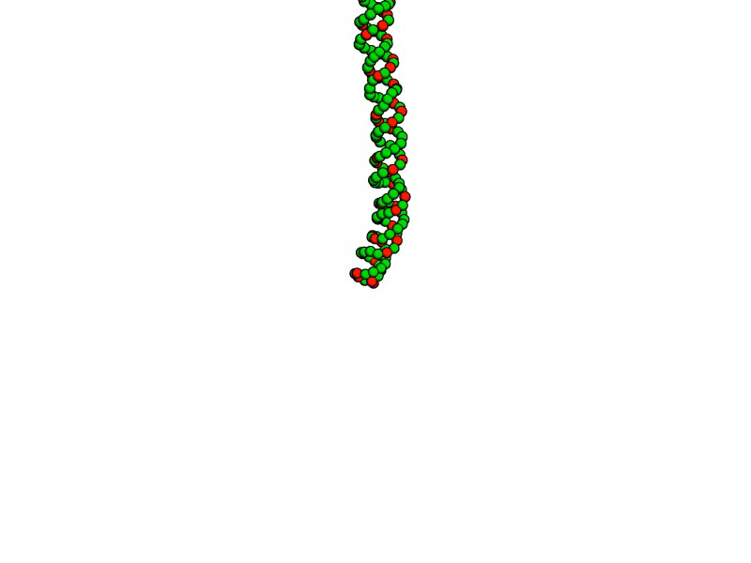
BASE PAIR STEPS – GLOBAL poly r(AC)₃ • poly r(GU)₃

Slide 34

BASE PAIR STEPS – GLOBAL Modelled vs. Experimental a In range with Hagerman, higher than Abels et al.
Reduce table to
Experimental and modelled values.
Persistence length derived from
X-ray structure analysis suggests
that RNA is stiffer than DNA and
in the range of Hagerman but
slightly higher than Abels and Dekker.

Slide 35
ACT IV
Finding RNA structural motifs using base step parameters.

Slide 36

RNA STRUCTURAL MOTIFS getMotif: A simple program to find RNA motifs based on single stranded base step parameters.
getMotif uses a seed of single-stranded
base step parameters to apply a sliding
window technique to localize RNA
structural motifs in any RNA structure
given in pdb format.

Slide 37



RNA STRUCTURAL MOTIFS Testing the getMotif program using the GNRA Tetraloop Motif
GNRA tetraloop provides
good “toy” model to test getMotif
The first step in GNRA is quite far
from canonical A-RNA. NR, and RA
Steps are closer save for having
Greater slide and being overtwisted.

Slide 38

RNA STRUCTURAL MOTIFS Sum of differences score for a sliding window finds potential GNRA tetraloop motif candidates.
Sum of difference score for the large
subunuit of the ribosome,
PDB_ID:1FFK, compared to the
GNRA tetraloops base steps.
Notes:
Make a sliding windows image.
An image with matrices in color which slides, remember Manju Bansal’s slides and Dr. Olson’s suggestion.

Slide 39

RNA STRUCTURAL MOTIFS The sum of differences score between single stranded base steps recognizes two GNRA groups.
GNRA recognizes two GNRA-like
motifs.
In red the “canonical” GNRA tetraloop
motif. In blue the lonepair triloop motif.
Add base in pentaloops and
Tell how many in other slide

Slide 40

RNA STRUCTURAL MOTIFS Group II candidate is the lone-pair triloop motif, or a composite GNRA motif.
The GNRA-like candidates
apparently lacking the
G-A base-pair, form a lonepair
triloop motif, which is just a structural
GNRA motif, with a non-sequential
closing base-pair.

Slide 41
FINALE
Missing conformations on classification of RNA dinucleotide steps can be found using rigid-body parameters.
Base pairs in RNA helical regions in X-ray structures arrange in seven predominant types.
Rigid body parameters for the 10 Unique RNA base-pair steps formed from canonical base-pairs allow us to model polymer chains and compute the dependence of persistence length on chain lengths.
A new software for finding RNA motifs based on rigid-body parameters successfully finds the GNRA motifs.
Notes:
Add conclusions to each act.
Future, open questions, coming attractions.

Slide 42
FINALE Future and developing work.
Expand rnasteps.rutgers.edu to periodically synchronize its data with the PDB in an automated fashion.
Construction of a dataset of base-step parameters for known RNA motifs to be used in the getMotif software.
Migrating the getMotif fully to python.
Develop a webbased front end to getMotif.
Notes:
Add conclusions to each act.
Future, open questions, coming attractions.

Slide 43

Thanks to my defense committee members for making it easy to schedule
this defense and your valuable time.
Special thanks to all members of the Olson Lab,
past and present.
Thanks to all for your attention,
Visit us at: http://dnaserver.rutgers.edu

Slide 44


Slide 45

BASE PAIR STEPS Energy contours on data culled by three standard deviations from the mean.
Notes:
This will just go from going into the website.

Slide 46
RNA STRUCTURAL MOTIFS Sum of differences score for a sliding window finds potential GNRA tetraloop motif candidates.
This is for 1FFK
Sliding windows image
Image with matrices in color
Boxes
e.g.
--- ---- ----
---- ---- -----
--- ---- ----
Notes:
Make a sliding windows image.
An image with matrices in color which slides, remember Manju Bansal’s slides and Dr. Olson’s suggestion.

Slide 47


